Slide 1

Vehicle & Pedestrian Detection and Classification System Using SingleShot multibox Detector (SSD)
Seminar Second Seminar
Name Tin Ko Ko Win
Supervisor Dr. Khine Moe Nwe
Date 05.03.2020

Slide 2
Content
Abstract
Introduction
Thesis Objective
Related Work
Theory Background
Convolutional Neural Network
Convolution
ReLU
Max Pooling
Flattening
Fully Connected Layer
Dataset
System Overview
Training
Preprocessing
SSD
Base Convolution
Auxiliary Convolution
Perdition Convolution
Prior boxes
How to find 8732 ground true?
Train
Multibox Loss
Location Loss
Encoding
Confident Loss
Testing or Validation
Evaluation
Mean Average Precision
Decoding
Non Max Suppression
Inferencing
System Flow
Example of How Location and Class Predicted from An Image with A Trained Model
Thesis Schedule
Conclusion

Slide 3
Abstract
Artificial Intelligence is major factor in Computer Vision
Interpretation of real world to computers
Far better than traditional methods with deep learning
Detect and classify vehicles & pedestrian
Can greatly assist self-driving cars
If adequate hardware, it’ll able to apply in real-time applications

Slide 4

Introduction
Practical with huge-improvement of hardware in recent years
Computer vision can be utilized in many fields
Primary process in automotive machines
Self-driving cars will be major role people’s transportation
Will reduce a lot of fatalities if we could develop good object detection system
Implement with SingleShot multibox Detector and use KITTI dataset for training

Slide 5

Thesis Objective
To learn about capabilities of deep learning and computer vision
To study how deep learning theories implemented in real-world applications
To get better trade-off accuracy and speed in object detection
To develop an object detection system with SSD that can work on user grade computers
To assist in self-driving cars

Slide 6
Related Works
Due to the usefulness of this cutting-edge technology, SSD have been used by researchers in many computer vision related field. I'll describe some recent related work.

Slide 7
1. Abandoned Object Detection
Authors - Devadeep Shyam, Alex Kot and Chinmayee Athalye
Method - Used finite state machine and Single Shot MultiBox Detecctor
To detect person and some suspected type of objects which include backpack, handbag
In order to suppress any false alarm, they remove other stationary candidate objects other than the suspected stationary objects
2. SSD-MSN: An Improved Multi-Scale Object Detection Network Based on SSD
Authors - ZUGE CHEN , KEHE WU, YUANBO LI, MINJIAN WANG, AND WEI LI
Method - SSD-MSN
Proposed Area Proposal Network(APN) to get better performance on small scale image
APN used to select area proposal containing one or more object while SSD is predicting location and classification
Used PASCAL VOC and COCO dataset and found that SSD-MSL improved multi-scale object detection effectively

Slide 8
3. Ship Detection System
Authors - Yuanyuan Wang , Chao Wang, Hong Zhang, Cheng Zhang, and Qiaoyan Fu
Method - Single Shot Multibox Detector
Used both SSD-300 and SSD-512
Images acquired by Chinese Gaofen-3 satellite are used
Experimental results reveal that compared to SSD-300, SSD-512 achieves more than 0.02 in probability of ship detection, whereas 0.05 worse in false alarm.

Slide 9
Theory Background

Slide 10
Convolutional Neural Network (CNN )
Yan LeCun (1998 ) ( Gradient Based Learning in Document Recognition )
Alex Krizhevsky ( ImageNet Large Scale Visual Recognition Challenge 2012 )
It’s the one of the most important invention in Computer Vision
More deeper than ANN
It can break down into five steps
Convolution -> ReLU -> Max Pooling -> Flattening -> Fully Connected Layer

Slide 11
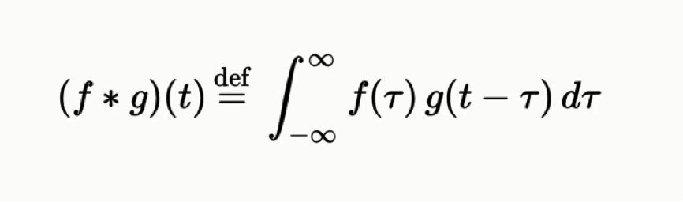
Convolution
For black images, only one color channel ranging from 0-255, three channels for color images.
Convolution is the pair wise multiplication with input images and random feature generator ( weights )
Got multiple feature maps and got random features ( edges, sharpen, blur etc. )
Demonstrated these as follow
Convolution Formula

Slide 12
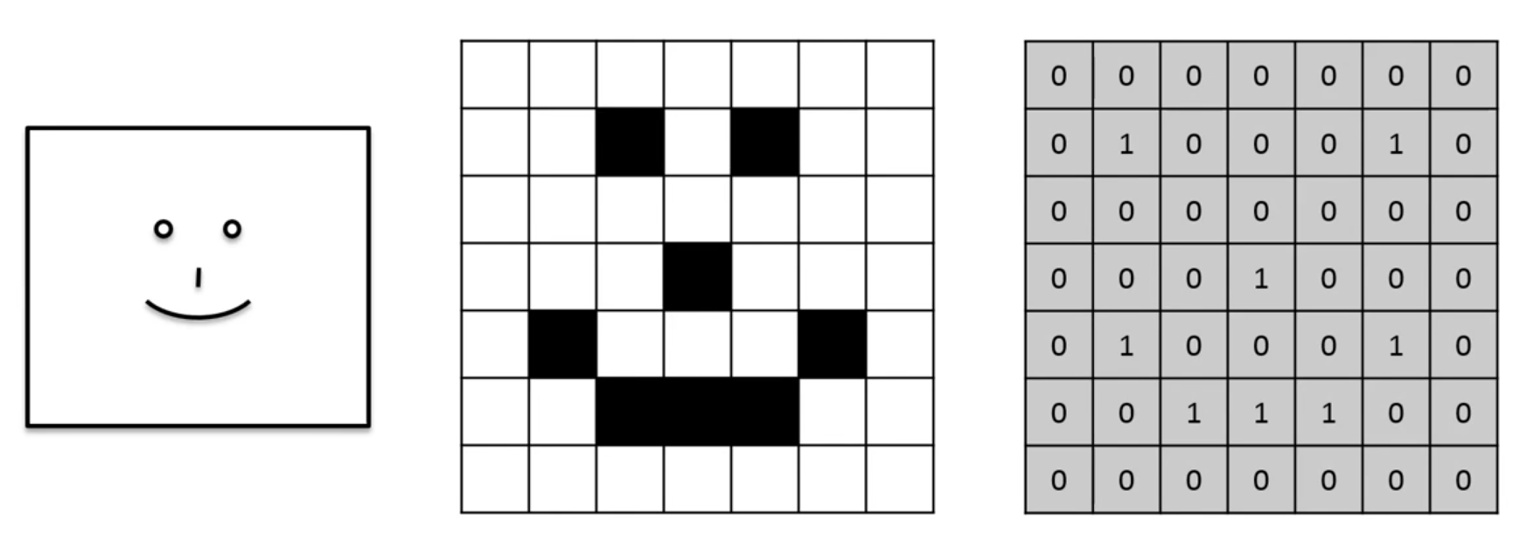
Convolution(cont..)
How images are presented

Slide 13
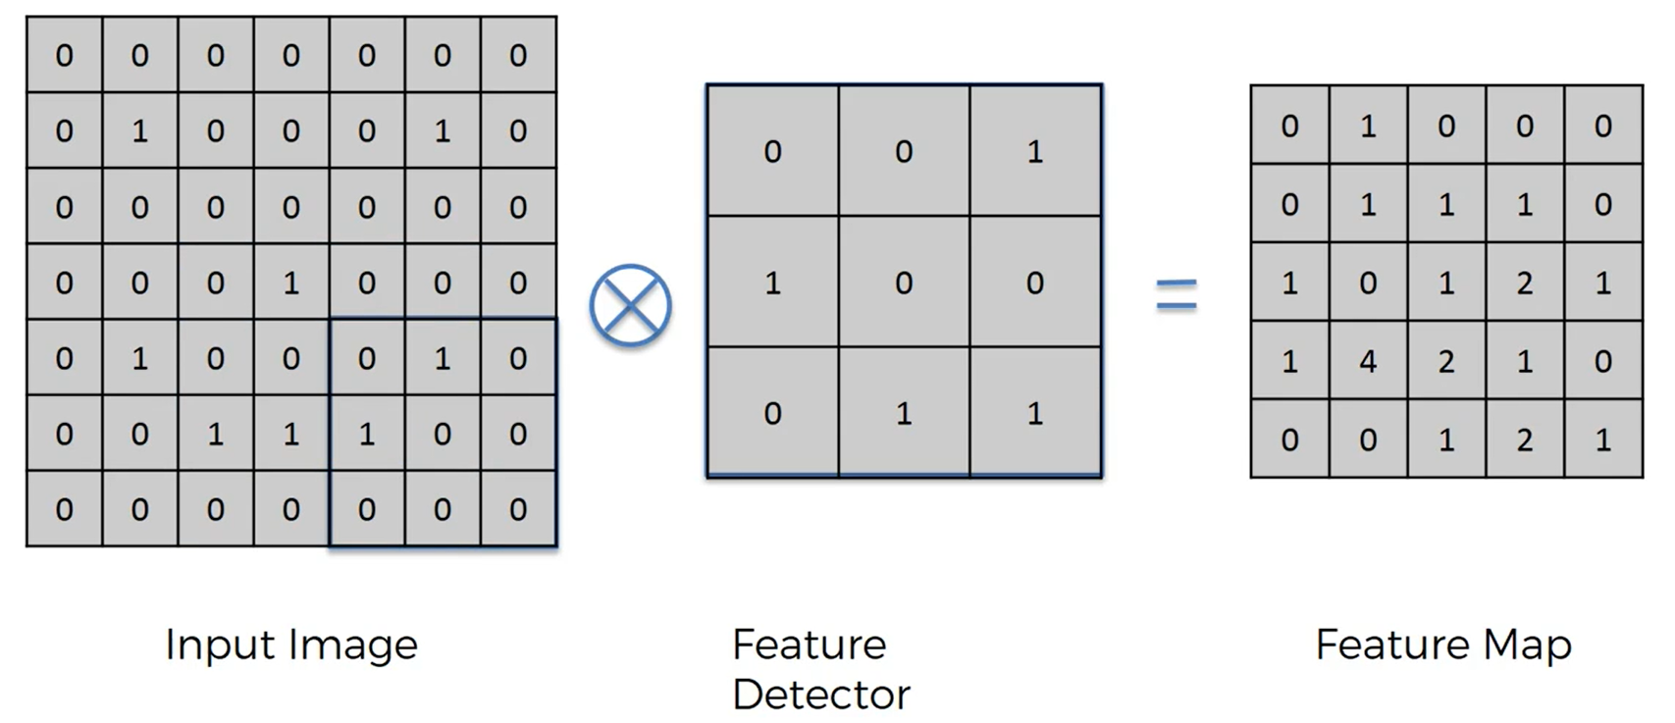
Convolution(cont..)
How convolution step work

Slide 14
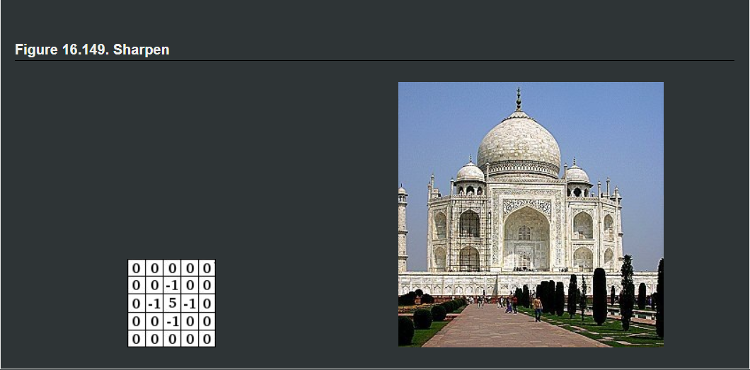
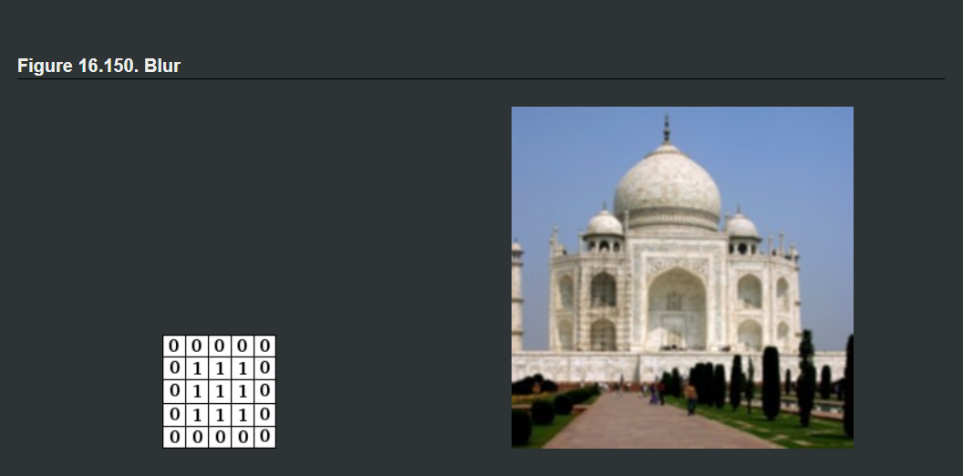
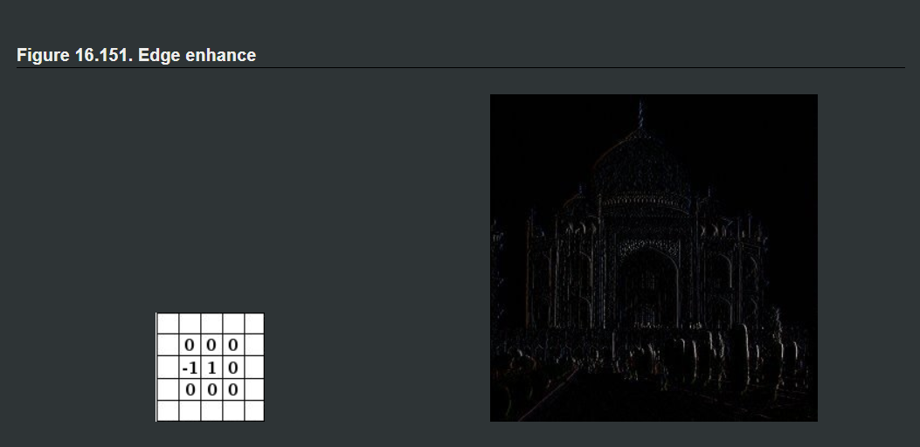
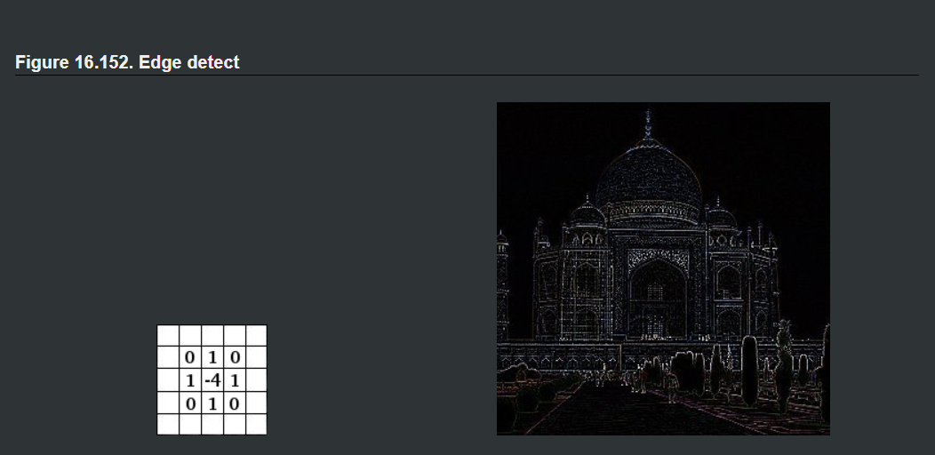
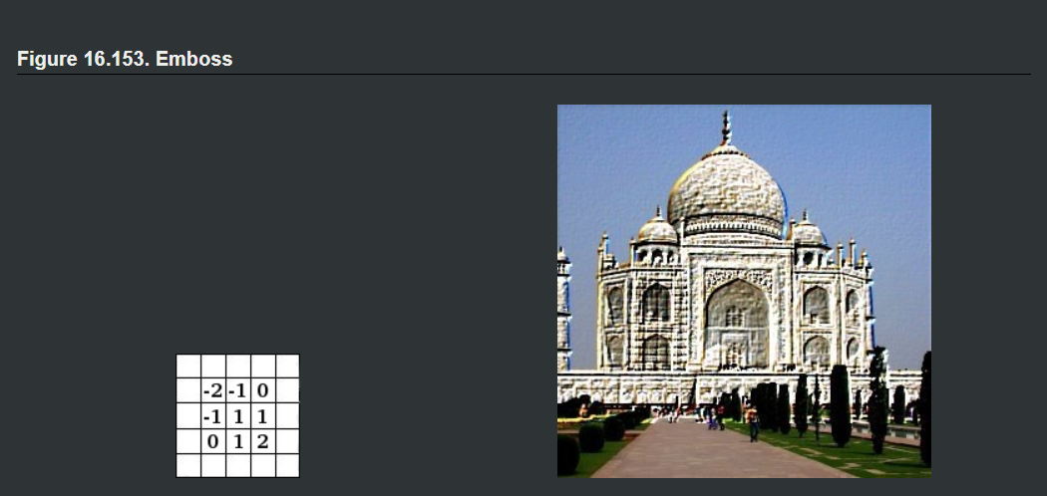
Example of feature maps

Slide 15
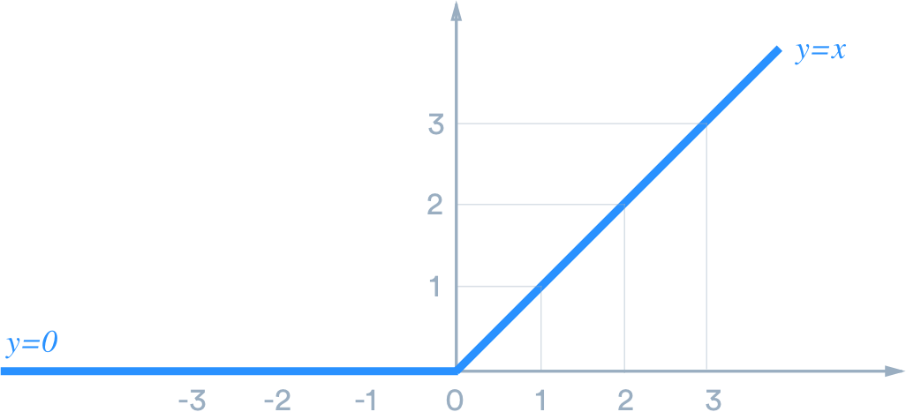
Rectified Linear Unit(ReLU)
Activation function that come after convolution
Break linearity
Without non-linearity, the model will work as there is only one layer whatever how many layers is
Moreover, it possible for gradient descent
Formula for ReLU
y = max(0, x)

Slide 16
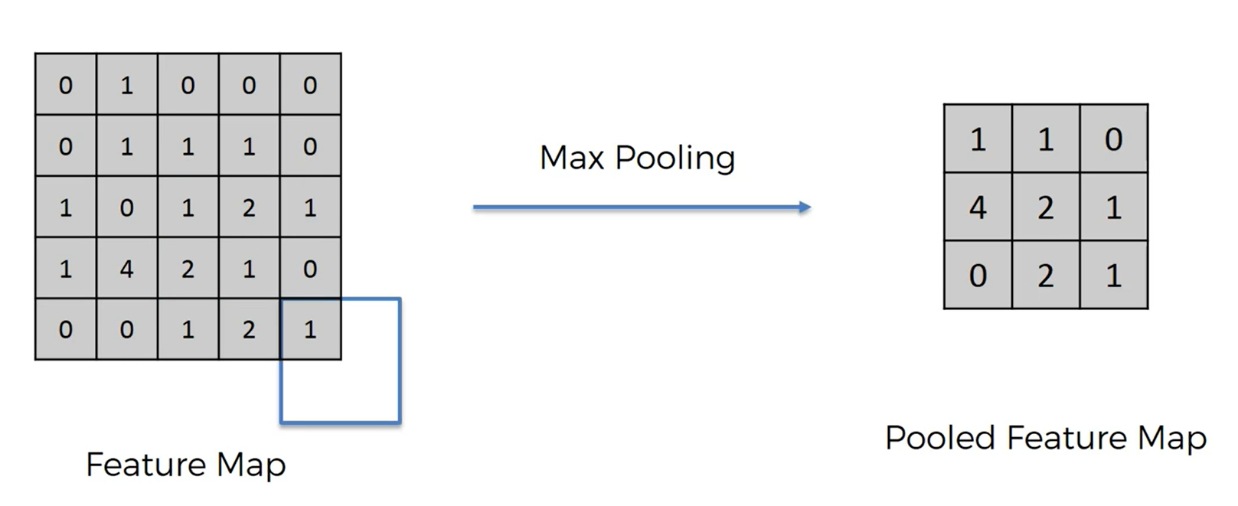
Max Pooling
Take out only the maximum index within specific matrix
To learn parts of the images
Reduce the size of feature maps

Slide 17
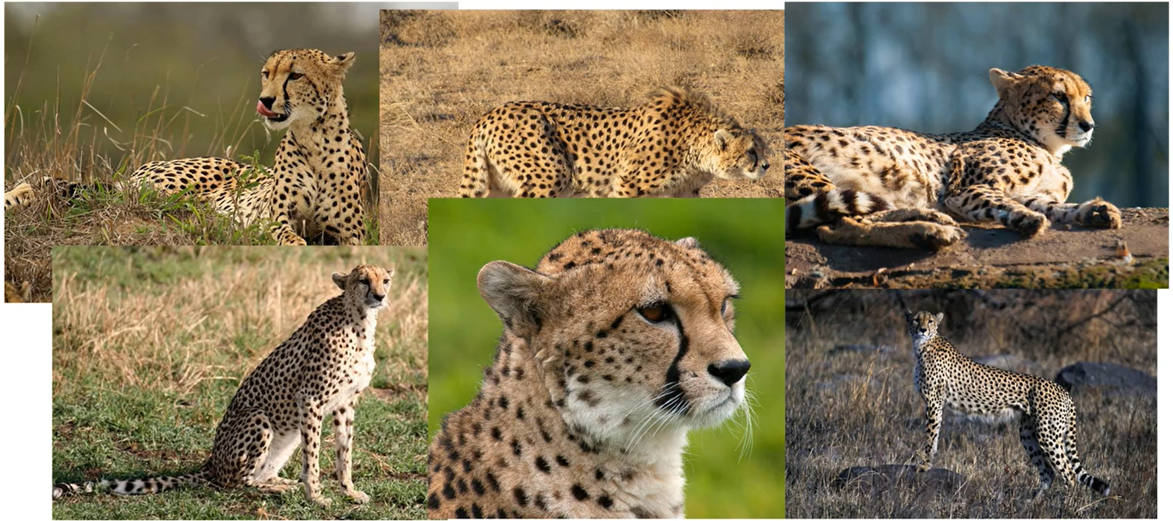
Max Pooling (cont…)
Why Max Pooling?

Slide 18
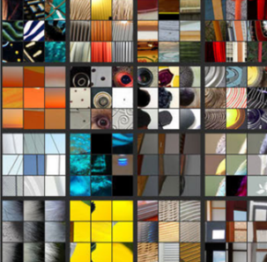
Example Features From Max Pooling

Slide 19
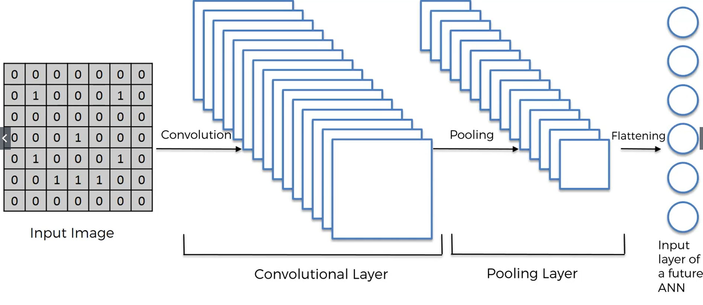
Flattening

Slide 20

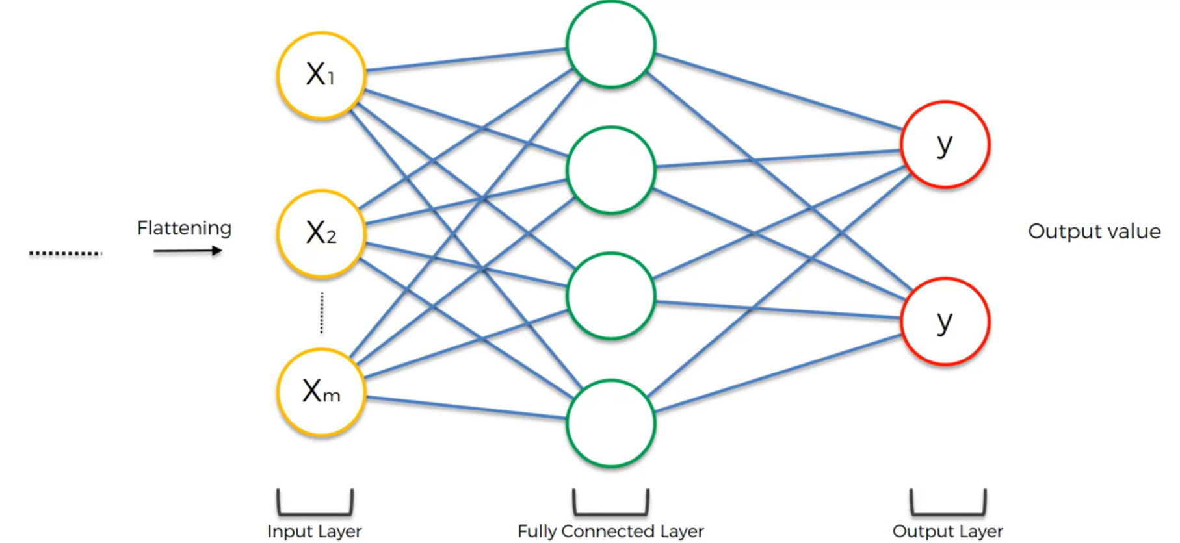
Fully connected layer
Connected all neurons from flattening and act as hidden layer in neural network
Use Softmax for classification and Sigmoid for regression

Slide 21
Dataset
Got from KITTI Vision Benchmark Suite and created by Karlsruhe Institute of Technology
Dataset that use in developing automotive driving cars by Team AnnieWay
Images got from two high-resolution color and grayscale video cameras
Ground truth is provided by a laser scanner and a GPS localization system
Captured by driving around the mid-size city of Karlsruhe, in rural areas and on highways.
Up to 15 cars and 30 pedestrians are visible per image.
Consists of 7481 training images and 7518 test images, comprising a total of 80256 labeled objects
Objects’ labels include 'Car', 'Van', 'Truck','Pedestrian', 'Person_sitting', 'Cyclist', 'Tram','Misc' or 'DontCare’ (1)

Slide 22
System Overview
Training
Training Dataset
Preprocess
SingleShot multibox Detector (SSD)
Model
Train
Loss
Testing or Validation
Testing Dataset
Preprocess
Trained Model
Loss

Slide 23
System Overview(cont..)
Evaluation
Testing Dataset
Preprocess
Trained Model
Decode
Evaluation Criteria
Model’s Performance
Inference
Image or Video
Preprocess
Trained Model
Decode
Draw box and label
Image with predicted info

Slide 24
Training
Preprocessing
First step in system as it is elementary
Four stages are included
Resizing , Photometric Distortion, Random Cropping, Random Flipping
Training
Training Dataset
Preprocess
SSD
Model
Train
Loss

Slide 25
Preprocessing(cont..)
They refresh in every iteration except resizing
Very important step because of making the model to get more data
Resizing
It is pretty obvious that is need to resize all the images wrt model’s dimensions (300*300 for my model)
Photometric Distortion
Distort brightness, contrast, saturation, and hue, each with a 50% chance, in random order
Random Cropping and Random Flipping
Randomly cropped and flip images with 50% chance

Slide 26
SingleShot multibox Detector(SSD)
Base Convolution, Auxiliary Convolution, Prediction Convolution (5)
Base Convolution
Use VGG16 that is trained on ImageNet by transfer learning
Take out conv4-3,and conv7 for Prediction Convolution
Dimension are halved into 38*38 in conv4-3 and 19*19 in conv7 ( 300*300->150*150 (pool 1) , 150*150->75*75(pool 2) , 75*75-> 38*38(pool 3 ceiling mode in this pooling ), 38*38->19*19 (pool 4) )
In original VGG16 fc6 and fc7 ( Fully connected layers )

Slide 27
SSD(cont..)
Need to convert into convolution and subsample by decimation ( in original VGG16 there is 4096 filters(feature detectors) but we just want only 1024 filters for our model to reduce computational expensivity )
Auxiliary Convolution
SSD add more convolution layers for different scale objects
Four layers for prediction
Conv8-2,Conv9-2,Conv10-2,Conv11-2 and dimensions are 10*10,5*5,3*3 and 1*1

Slide 28
SSD(cont..)
Prediction Convolution
This part is where we get location and class for input images for every pixels of the feature map
That mean for conv4-3, yield 38*38 class prediction
More in location
This numbers of locations predicted here is as follow..

Slide 29
Prediction Convolution(cont..)
Conv4-3 -> 4 locations (4 * 38 *38)
Conv7 -> 6 locations (6 *19*19)
Conv8-2 -> 6 locations (6 * 10*10)
Conv9-2 -> 6 locations (6 *5*5)
Conv10-2 -> 4 locations (4*3*3)
Conv11-2 -> 4 locations (4*1*1)
Total of 8732 location predictions

Slide 30
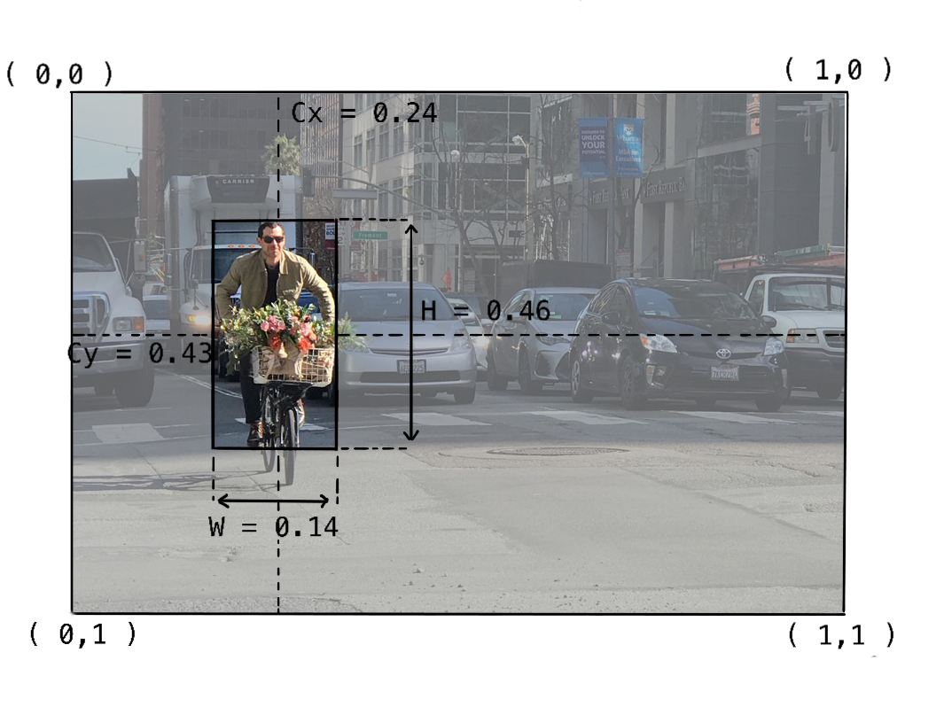
Prior Boxes
Prior boxes presentations
Center-Size Presentation

Slide 31
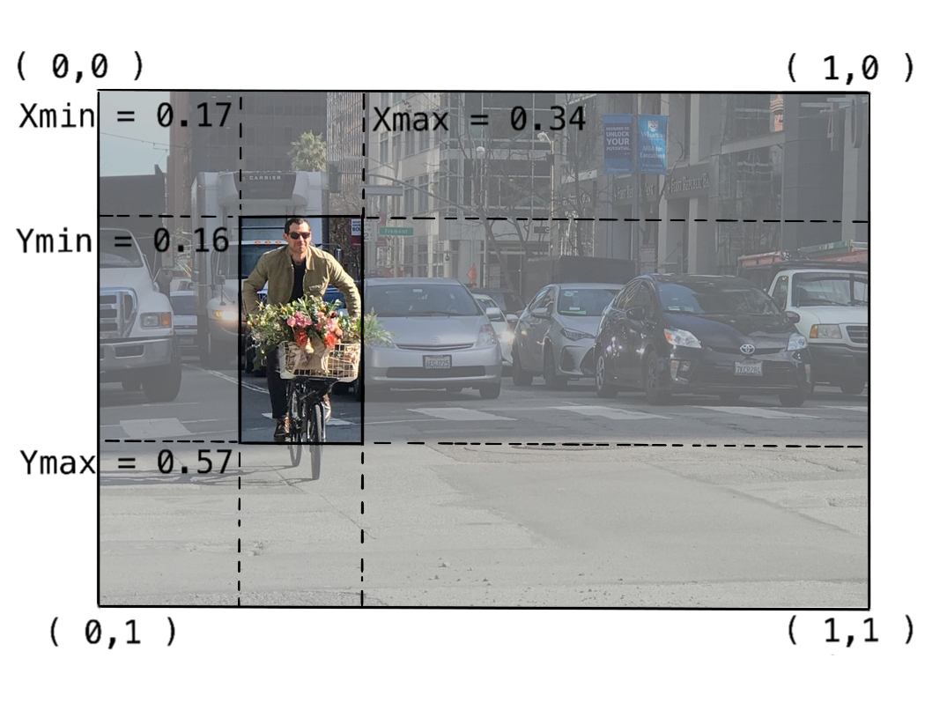
Prior Boxes(cont...)
Boundary Presentation

Slide 32
Prior Boxes(cont..)
How prior boxes are created? (7)
Prior boxes are created with scale and aspect ratios
Scale
Conv4_3 : 0.2, Conv7 : 0.2, Conv8_2 : 0.375, Conv9_2 : 0.55, Conv10_2 : 0.725, Conv11_2 : 0.9
Aspect Ratios
Conv4_3 : 1, 2/1, 1/2, the ratio between this and the next layer
Conv7 : 1, 2/1, 3/1, 1/2, 1/3, the ratio between this and the next layer

Slide 33
Prior Boxes(cont..)
Conv8_2 : 1, 2/1, 3/1, 1/2, 1/3, the ratio between this and the next layer
Conv9_2 : 1, 2/1, 3/1, 1/2, 1/3, the ratio between this and the next layer
Conv10_2 : 1, 2/1, 1/2, the ratio between this and the next layer
Conv11_2 : 1, 2/1, 1/2, the ratio between this and the next layer
prior boxes per feature map(exclude prior box between current and next feature map)
Cx - j + 0.5 / feature map dimension ( j is each pixel in feature map )
Cy - i + 0.5 / feature map dimension ( i is each pixel in feature map )
Width - prior box scale of current feature map * square root of each aspect ratio in current feature map ( may be 3 or 5 wrt feature map )

Slide 34
Prior Boxes (cont..)
High - prior box scale of current feature map / square root of each aspect ratio in current feature map ( may be 3 or 5 wrt feature map )
prior box between current and next feature map(not in Conv11_2 as it is a last feature and there is no next feature map)
Cx - j + 0.5 / feature map dimension ( j is each pixel in feature map )
Cy - i + 0.5 / feature map dimension ( i is each pixel in feature map )
Width, High - square root of the multiplication of prior box scale of current feature map and prior box scale of next feature map

Slide 35
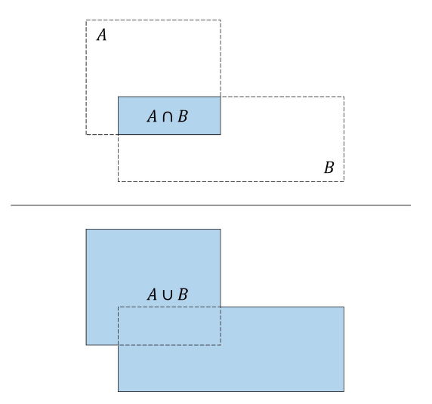
How to Find 8732 ground true?
Create 8732 prior boxes ( slide 32-34 )
Jaccard Overlap between prior boxes and ground true boxes.
Find what priors overlapped most to which object.
Priors that doesn’t overlap over threshold is set to background label.
Label the location wrt priors max overlapped to ground true boxes
Jaccard Overlap ( Intersection over Union )
Criteria that say how much two locations are overlapped.
The formula of JO is
Jaccard Overlap = A Ո B / A U B(2)

Slide 36
Train
Multibox Loss
Localization loss
Confident loss ( class score )
Total loss = L (conf) + α L (loc) (α = learning rate )
Location loss
Find the ground true location for 8732 boxes (slide 35)
Encode the positive location(non background)
Smooth L1 loss

Slide 37
Encoding
In SSD, we find gradient descent with the offset not the real boxes’ location
We need to encode the true location for our loss function
Find offset between the predicted boxes and their corresponding prior boxes (3)
For center-sized representation
Let say predicted boxes are [ xpre ,ypre , wpre , hpre ] and prior boxes are [ xpri ,ypri , wpri , hpri]
The formula is…
x’ = ( xpre - xpri / wpri)
y’ = ( ypre - ypri / hpri )

Slide 38
Encoding (cont..)
w’ = ln [ wpre / wpri]
h’ = ln [ hpre / hpri ]
For boundary representation
Let say predicted boxes are [ xmin_pre ,ymin_pre , xmax_pre , ymax_pre] and prior box are [ xmin_pri,ymin_pri , xmax_pri , ymax_pri ]
The formula is…
x’min = xmin_pre - xmin_pri / wpri
x’max = xmax_pre - xmax_pri / wpri
y’min = ymin_pre - ymin_pri / hpri
y’max = ymax_pre - xmax_pri / hpri

Slide 39
Confident Loss
Loss = positive + hard negative
Loss function = cross entropy loss
number of hard negative = 3 * number of positive
Hard negative = most negative priors in each image ( Hard Negative Mining )
(8)
Notes:
most negative mean greatest loss that got from cross entropy loss

Slide 40
Testing or Validation
Preprocessing
Just only need resizing.
Model
Use model got from training
Testing or Validation
Testing Dataset
Preprocess
Trained Model
Loss

Slide 41
Evaluation
Judging the model performance
Evaluation and inferencing are the actual use case of the model
Need to limit only one location and label for one object
Preprocess
Just only need resizing.
Evaluation
Testing Dataset
Preprocess
Trained Model
Decode
Evaluation Criteria
Model’s Performance

Slide 42
Evaluation(cont..)
Model
Use model got from training
Evaluation Criteria
Because of object detection, can’t use confusion matrix as evaluation matrix and therefore will use Mean Average Precision (4)
These will include in my Mean Average Precision..
Precision
Recall
Precision
How accurate your prediction is. How much percentage your prediction is correct.

Slide 43
Evaluation (cont..)
Precision = True Positive / True Positive + False Positive ( True Positive / All of Prediction )
Recall
How good in finding true positive
Recall = True Positive / True Positive + False Negative ( True Positive / All of case )
How to find mean average precision?
Decode and Non Max Suppress the predicted boxes
For every single predicted boxes that match ground true boxes greater than threshold are set as true positive
Others are false positive
Notes:
Precision and Recall Example ( picking red ball form red , green , blue balls )

Slide 44
Evaluation (cont..)
Find cumulative true positive and false positive
Then find cumulative precision and recall
Set 11 point recall threshold (0,0.1,0.2,…..,1)
Find the precision wrt cumulative precision and choose the maximum for 11 points
The mean for this 11 points
Decoding and Non Max Suppression
Decoding
Decipher the predicted boxes as the prediction are encoded ( offset to the ground true boxes ) (3)

Slide 45
Decoding(cont..)
For center-sized presentation
Let say predicted boxes are [ xpre ,ypre , wpre , hpre ] and prior boxes are [ xpri ,ypri , wpri , hpri]
The formula is…
xpre ‘ = xpre * wpri + xpri
xpre ‘ = ypre * hpri + ypri
wpre ‘ = exp (wpre) wpri
hpre ‘ = exp (hpre) hpri

Slide 46
Decoding (cont..)
For boundary representation
Let say predicted boxes are [ xmin_pre ,ymin_pre , xmax_pre , ymax_pre] and prior box are [ xmin_pri,ymin_pri , xmax_pri , ymax_pri ]
The formula is…
xmin_pre‘ = ( xmin_pre * wpri ) + xmin_pri
ymin_pre‘ = ( ymin_pre * hpri ) + ymin_pri
xmax_pre‘ = ( xmax_pre * wpri ) + xmax_pri
ymax_pre ‘ = ( ymax_pre * hpri ) + ymax_pri

Slide 47
Non Max Suppression
As there may be many boxes that may be greater than threshold, we need to suppress these
Moreover, it is sure that one object may be detected by more than one box
The technique is non max suppression
How to do this?
Use softmax function to get predicted class score ranking.
Decode the predicted locations
We will reject all that the score lower than specific threshold ( may be 0.2 or 0.5, can get from empirical results )

Slide 48
Non Max Suppression (cont..)
Sort the passed locations in order of decreasing score
JO between the passed predictions
I will suppress all boxes that the overlap is lower than Maximum overlap threshold
I will demonstrate this as follow.. (6)

Slide 49
Inference
Only need resizing in preprocess like testing and evaluation
I’m going to use the Trained Model
Decode and NMS
Re-configure our predict image to its original dimensions
Draw a rectangle and write labels on image wrt our prediction
Inference
Image or Video
Preprocess
Trained Model
Decode
Draw box and label
Image with predicted info

Slide 50
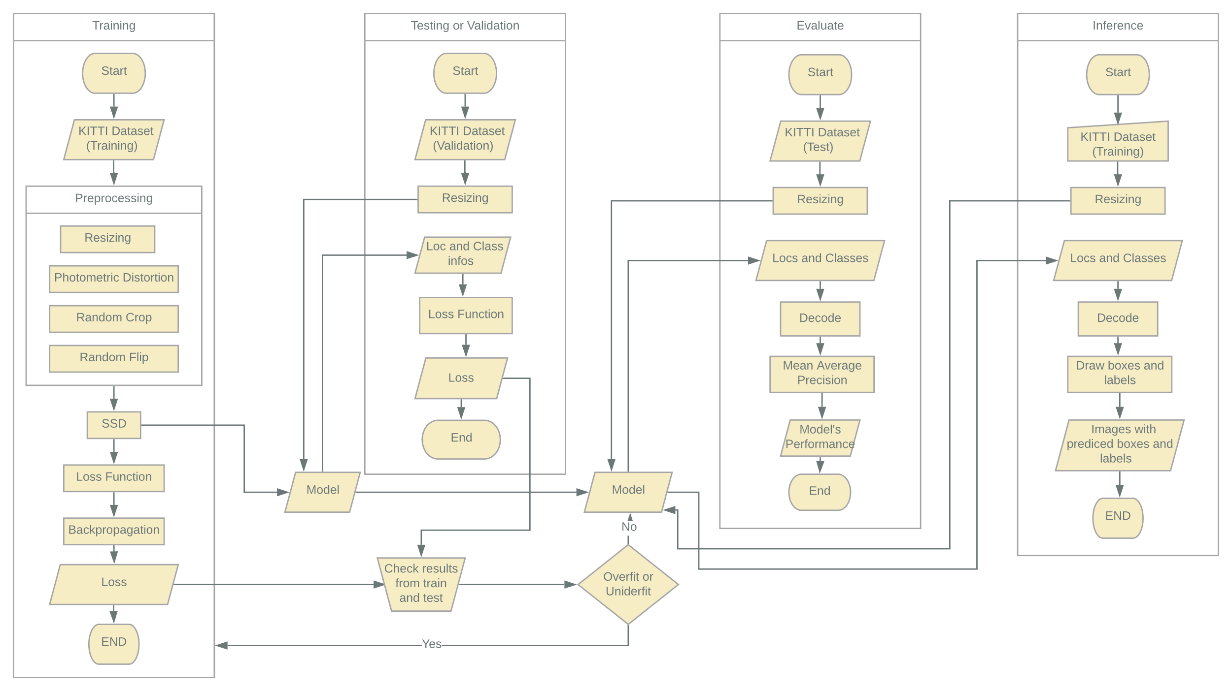
System Flow

Slide 51
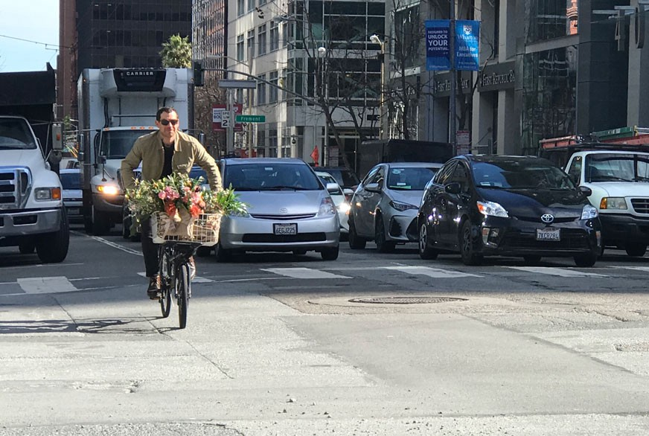
Example of How Location and Class Predicted from An Image with A Trained Model
Preprocessing
0.32 | 0.65 | 0.91 | ……. | 0.00 | 0.00 | 0.00
0.63 | 0.21 | 0.42 | ……. | 0.64 | 0.78 | 0.36
0.44 | 0.22 | 0.75 | ……. | 0.33 | 0.39 | 0.45
….. | ….. | ….. | ….. | ….. | ….. | …..
0.49 | 0.22 | 0.00 | ……. | 0.00 | 0.00 | 0.00
0.16 | 0.72 | 0.66 | ……. | 0.58 | 0.79 | 0.27
0.65 | 0.42 | 0.93 | ……. | 0.77 | 0.52 | 0.43
torchvision.transforms.functional.to_tensor
torchvision.transforms.functional.resize
An Image
An Image in Tensor shape

Slide 52

Example of How Location and Class Predicted from An Image with A Trained Model (cont..)
Base Convolution and Auxiliary Convolution
0.00 | 0.28 | 0.00 | ……. | 0.00 | 0.99 | 0.43
0.11 | 0.33 | 0.54 | ……. | 0.76 | 0.91 | 0.32
0.63 | 0.00 | 0.00 | ……. | 0.32 | 0.55 | 0.21
….. | ….. | ….. | ….. | ….. | ….. | …..
0.34 | 0.54 | 0.00 | ……. | 0.21 | 0.00 | 0.00
0.32 | 0.22 | 0.00 | ……. | 0.00 | 0.43 | 0.51
0.21 | 0.76 | 0.93 | ……. | 0.21 | 0.32 | 0.55
0.22 | 0.32 | …….. | 0.00 | 0.00
0.73 | 0.43 | …….. | 0.00 | 0.21
……… | ……… | ……… | ……… | ………
0.98 | 0.29 | …….. | 0.87 | 0.00
0.00 | 0.25 | …….. | 0.58 | 0.00
0.00 | 0.21 | 0.33
0.12 | 0.22 | 0.54
0.44 | 0.55 | 0.65
Max Pooling
0.00 | 0.54 | 0.00
0.22 | 0.31 | 0.42
0.86 | 0.67 | 0.31
Max Pooling
Filters
Filters
Image ( 150*150 )
Image ( 300*300)
Prediction Convolution
no: filters is ..
For loc – wrt layers
For class – no: class
0.42 | 0.11 | …….. | 0.62 | 0.00
0.53 | 0.81 | …….. | 0.41 | 0.00
……… | ……… | ……… | ……… | ………
0.27 | 0.00 | …….. | 0.00 | 0.21
0.82 | 0.22 | …….. | 0.97 | 0.72
0.00 | 0.21 | …….. | 0.65 | 0.72
0.73 | 0.26 | …….. | 0.92 | 0.21
……… | ……… | ……… | ……… | ………
0.82 | 0.44 | …….. | 0.00 | 0.00
0.33 | 0.87 | …….. | 0.75 | 0.96
Take out conv4_3,conv7, conv8_2, conv9_2,conv10_2 and conv11_2
for predicting loc and class
………….
0.42 | 0.65 | 0.21
0.14 | 0.00 | 0.00
0.00 | 0.21 | 0.56
Location and Class ( for location the size is ( 8732,prior_box) and for class the size is (8732,no: class)
………….
Filters
Image ( 75*75 )
Image_con4_3 ( 38*38 )

Slide 53
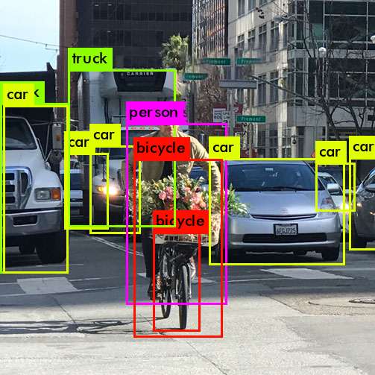
Example of How Location and Class Predicted from An Image with A Trained Model (cont..)
Decode and NMS(slide 46-51)
Draw Boxes and Labels using PIL library (ImageDraw,ImageFont)
Location and Class ( one location and class for each object in image )
Image with Predicted boxes and labels on Objects

Slide 54
Thesis Schedule
September
March
April
May
First Seminar
Second Seminar
Third Seminar
Defense

Slide 55
References
Karlsruhe Institute of Technology , nd , KITTI Vision Benchmark Suite , http://www.cvlibs.net/datasets/kitti/eval_object.php?obj_benchmark=2d
Eddie Forson, Nov 18 2017, Understanding SSD MultiBox — Real-Time Object Detection In Deep Learning, https://towardsdatascience.com/understanding-ssd-multibox-real-time-object-detection-in-deep-learning-495ef744fab
Lei Mao, April 08 2018 , Bounding Box Encoding and Decoding in Object Detection, https://leimao.github.io/blog/Bounding-Box-Encoding-Decoding/
Jonathan Hui, Mar 07 2018, mAP (mean Average Precision) for Object Detection, https://medium.com/@jonathan_hui/map-mean-average-precision-for-object-detection-45c121a31173
Liu W. et al. (2016) SSD: Single Shot MultiBox Detector. In: Leibe B., Matas J., Sebe N., Welling M. (eds) Computer Vision – ECCV 2016. ECCV 2016. Lecture Notes in Computer Science, vol 9905. Springer, Cham

Slide 56
References
Sagar Vinodababu,N.D, a PyTorch Tutorial to Object Detection, https://github.com/sgrvinod/a-PyTorch-Tutorial-to-Object-Detection
Aman Damia, May 1 2019, Real-time object detection: Understanding SSD, https://medium.com/inveterate-learner/real-time-object-detection-part-1-understanding-ssd-65797a5e675b
Chuan Li, January 06, 2019, Tips for implementing SSD Object Detection (with TensorFlow code), https://lambdalabs.com/blog/how-to-implement-ssd-object-detection-in-tensorflow/

Slide 57

Conclusion
SSD is the efficient object detection method.
01
The system can be utilized in various computer vision projects.
02
It is worth for further researches because of its advantages over competitors.
03

Slide 58
Thank You

